Slide 1
UX Roles in AI
Todd Eischeid, Principle UX Researcher
November 12, 2020

Slide 2
Introduction
User experience in Artificial Intelligence (AI) has many facets
Here I am mainly discussing Artificial Intelligence as it relates to user experience research and testing, and ways in which UX can contribute to AI related functionality.

Slide 3
Defining AI for UX

Slide 4
Defining AI for UX
Healthcare has different requirements than for typical consumer applications
Be cautious about applying guidance that is geared more toward general consumer applications, like ecommerce
users are experts in their fields
domain is very complex
efficiency privacy
safety

Slide 5
Defining AI for UX
Being more specific than “AI” when discussing designs and experience.
Technically there are numerous types of AI, but UX and designers don’t necessarily need to know those distinctions.

Slide 6
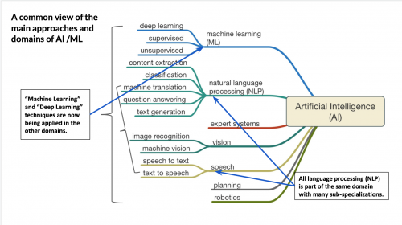

Slide 7
+

Slide 8
Defining AI for UX
We can define types of AI in terms of how it is surfaced in the user experience.
Giving commands to the system. Voice and chat assistants, conversational UI’s in general.
Dictation. Simple speech-to-text and parsing of text into more structured data.
Data/Information curation and suggesting action

Slide 9



Defining AI for UX
Examples
Giving commands to the system
Dictation
Data/Information curation
automate repetitive tasks such as eligibility checks and un-adjudicated claims
listens to a patient’s symptoms, guides that patient to the correct care based on its diagnosis.

Slide 10
Role of UX for AI functionality

Slide 11
Role of UX
User research activities are still very relevant and needed: interview, ethnographic, survey, etc.
AI systems can learn but they cannot figure out which problems to solve.
“if you aren’t aligned with a human need, you’re just going to build a very powerful system to address a very small — or perhaps nonexistent — problem.”

Slide 12
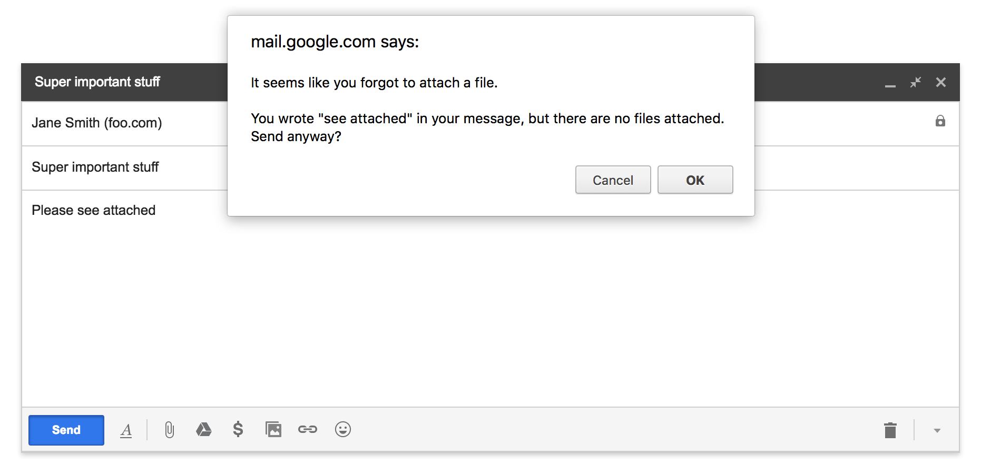
Role of UX
Know what to apply AI to and what not to. There are many types of experience features that seem ‘intelligent’ but don’t require an AI type of solution
Gmail can look for certain words and remind the user when they may have forgotten to attach a file. But this doesn’t require machine learning.

Slide 13
Role of UX
Plan for how the AI will learn over time.
For example, users may indicate that a suggestion made by the information curation is incorrect or not desired, or whether an assistant misinterpreted their intent.

Slide 14
Role of UX
UX researchers should have an understanding of the appropriate data needed to train the types of AI, both initially and over time as the user interacts with the system.
The training data should be informed by knowledge of users; an understanding of users jobs

Slide 15
Role of UX
User wants to: Get a specific recent patient lab test value.
How users might ask this:
"does the patient have a recent labTestName”
"what is the latest labTestName"
"is labTestName improving"
"what is the most recent labTestName"

Slide 16
Role of UX
Because of the dynamic nature of assistants and information curation, and potentially being more mysterious to the user, trust becomes more important.
when suggestions are made, do users trust them; what factors affect that trust.
When the system cannot correctly interpret a user request, how do we still maintain trust?

Slide 17
Role of UX
UX+AI Principles
May be helpful in guiding UX decisions when working with AI systems
Start with the user
Set the right expectations
Explain the results
Communicate confidence
Degrade gracefully
Know what not to automate
Keep the user in control
Build trust over time
+8 more. . .
https://uxofai.com

Slide 18
Role of UX – Communicating Requirements
How to communicate AI requirements to the larger team?
For example, for AI that is based on users giving commands to the system (e.g., conversational UI’s), there will be a defined set of actions that the system will support, and UX provides all of the ways that users might ask the system to do each action.
How will the system will gracefully degrade when a requested user action is not supported?
UX can provide guidance on prioritizing the supported user actions.

Slide 19
Role of UX – Communicating Requirements
For information/data curation types of AI, UX input depends on the type of information or type of suggestion.
For examples mentioned earlier, Buoy Health and Olive, UX activities might center around identifying repetitive, error prone tasks, user trust in suggestions made by the system, and whether users find the suggested results beneficial.

Slide 20
Prototyping and testing potential AI solutions
Wizard of Oz prototypes are effective and relatively low cost
Similar types of prototypes as UX currently uses, but testing includes trust, usefulness, etc.

